Slide 1
Title:-Contact Management System
A Java-based Phone Book Application
Presented by: Shruti Mule
Date:5/7/2025

Slide 2
Introduction:-
A Contact Management System helps users :-
1.Store
2.Retrieve
3.Update
4.Delete contact information
Developed using Java,JDBC,MySQL,and Swing GUI.

Slide 3
Objective:-
To design a user-friendly contact book application.
Enable users to:
1.Add new contacts
2.View all contacts
3.Search for a contact
4.Update or delete existing contacts.

Slide 4
Tools & Technologies:-
Java-core language
JDBC-connects Java to MySQL
MySQL-database
Intellij IDEA-IDE
Java Swing-GUI user interface

Slide 5
Features:-
Add contact
Search contact by name
View all contacts
Update contact
Delete contact

Slide 6
System Architecture:-
Frontend: Java Swing GUI
Backend: JDBC for database interaction
Database: MySQL

Slide 7
Implementation Overview:-
Contact.java – pojo class
ContactDAO.java – Handles database operation
ContactAppGUI.java – swing-based user interface
Main.java – Runs the app

Slide 8
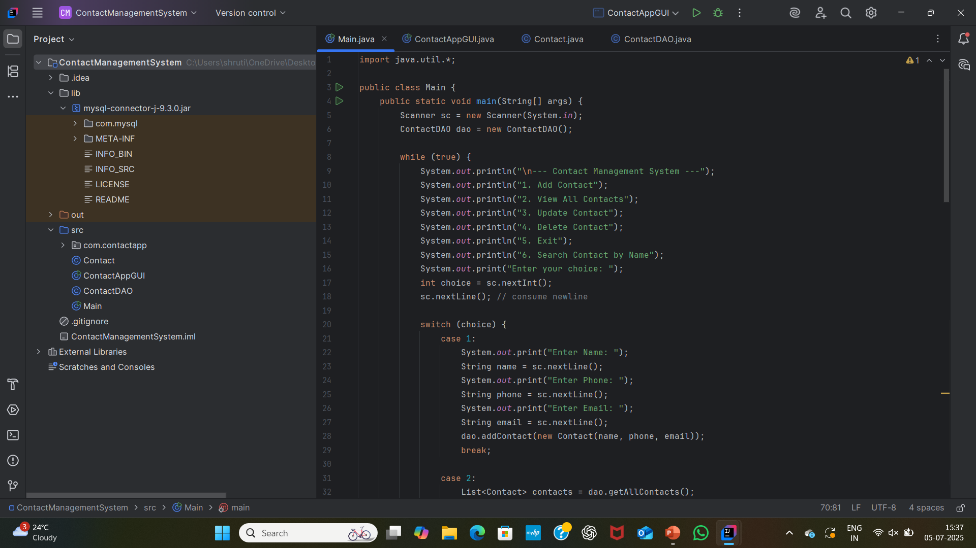
Screenshots:-

Slide 9
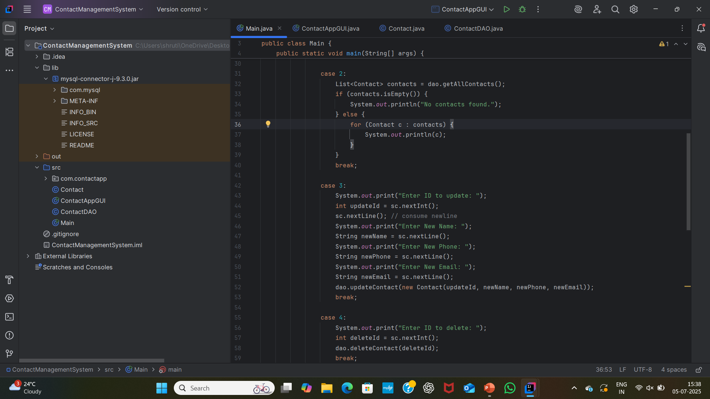
.

Slide 10

.

Slide 11

.

Slide 12
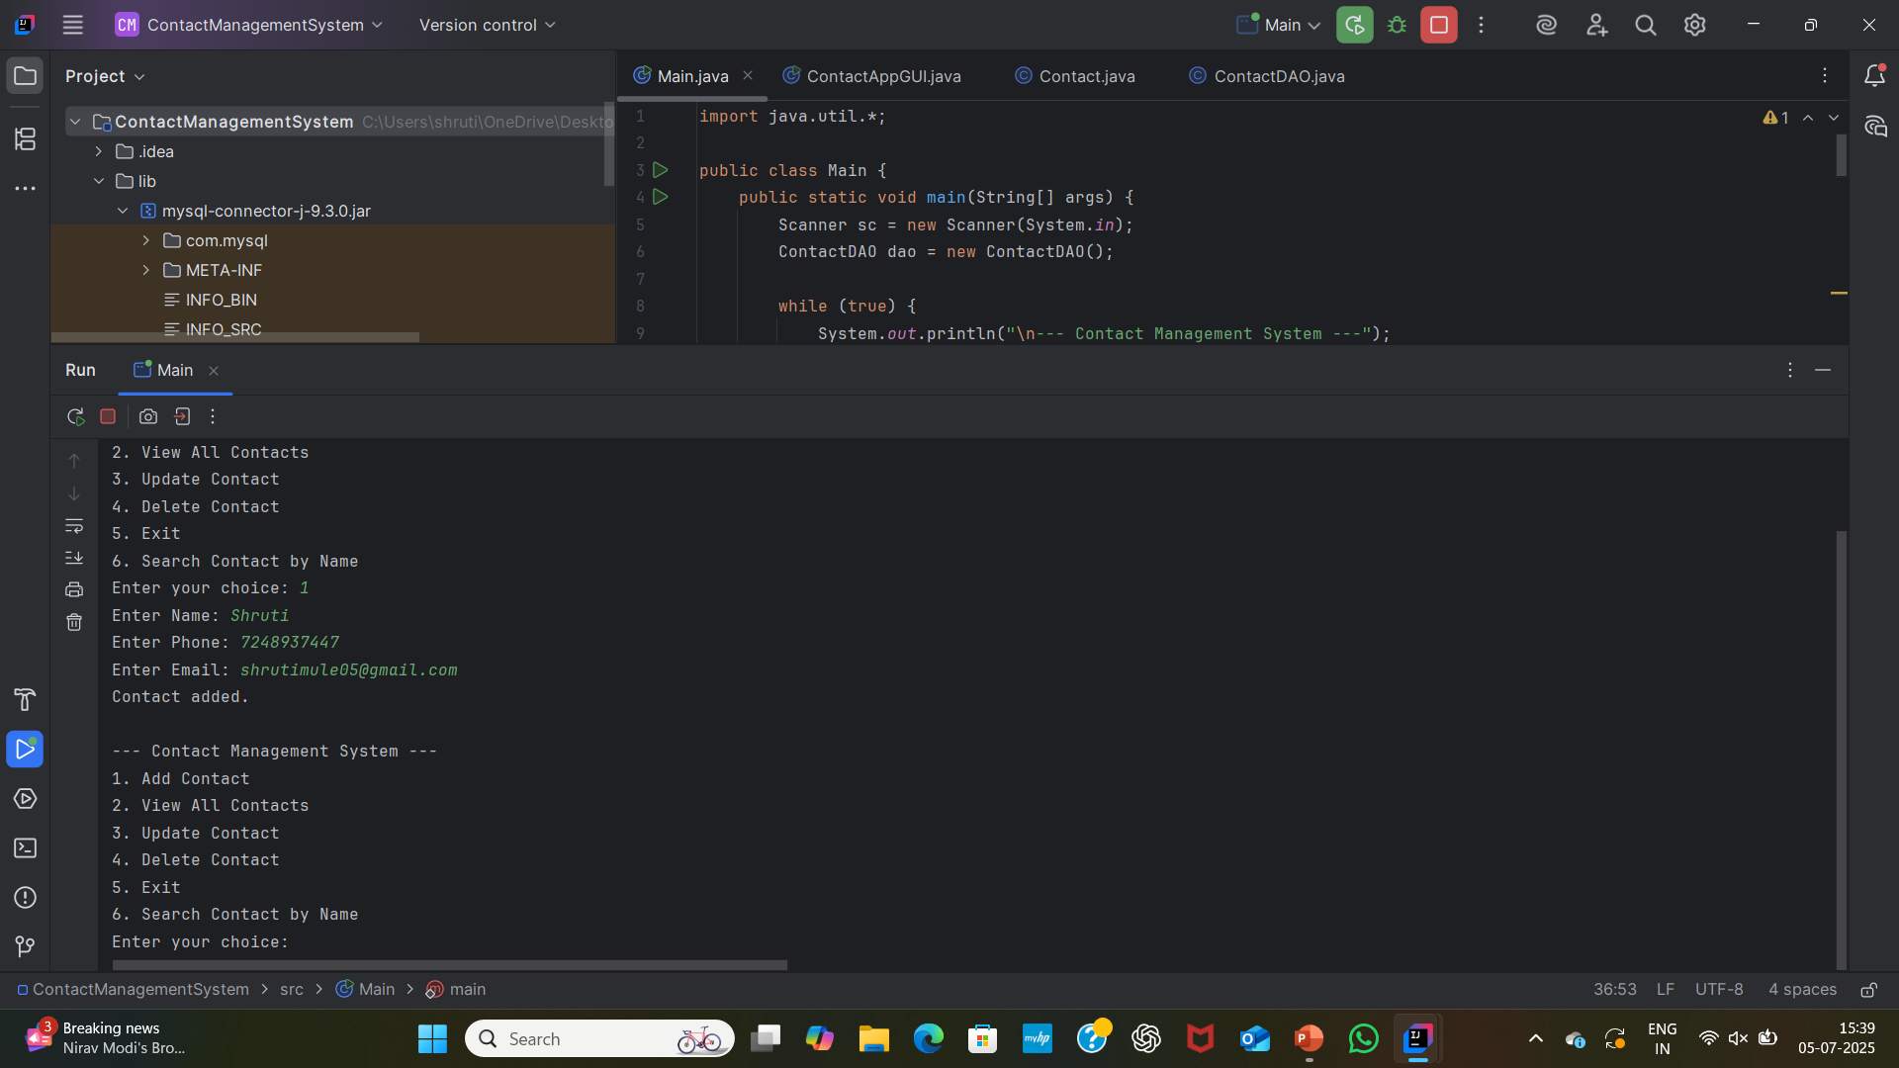
Output:

Slide 13
Benefits:-
Simple and easy-to-use
Desktop-based
Quick operations using GUI
Data safely stored in database

Slide 14
Future Enhancements:-
Add login authentication
Export contacts to PDF
Add profile pictures
Integrate with mobile devices

Slide 15
Conclusion:-
Built a fully Functional contact manager using java and jdbc
Real-time database operation
Learnings:GUI design,jdbc,database connectivity,CRUD operations.

Slide 16
THANK YOU!

